Slide 1
Data Science Capstone Project
Sanjeet Shrestha
https://github.com/shre6455/IBM_Data_Science_Professional_Certification
06/06/2026

Slide 2
Content
Executive Summary
Introduction
Methodology
Results
Conclusion
Appendix

Slide 3
Executive Summary
Collected data from the SpaceX API and SpaceX Wikipedia page. Created labels columns to identify successful landings. Performed exploratory data analysis using SQL, data visualizations, column maps, and dashboards. Selected relevant features for modeling, converted categorical variables using one-hot encoding, standardized the data, and applied GridSearchCV to optimize machine learning model parameters. Evaluated model performance using accuracy scores and confusion matrices.
Developed and evaluated four machine learning models: Logistic Regression, Support Vector Machine (SVM), Decision Tree Classifier, and K-Nearest Neighbors (KNN). All models achieved an accuracy of approximately 83.33%. The models tended to overpredict successful landings, indicating that additional data may be needed to improve model generalization and accuracy.

Slide 4
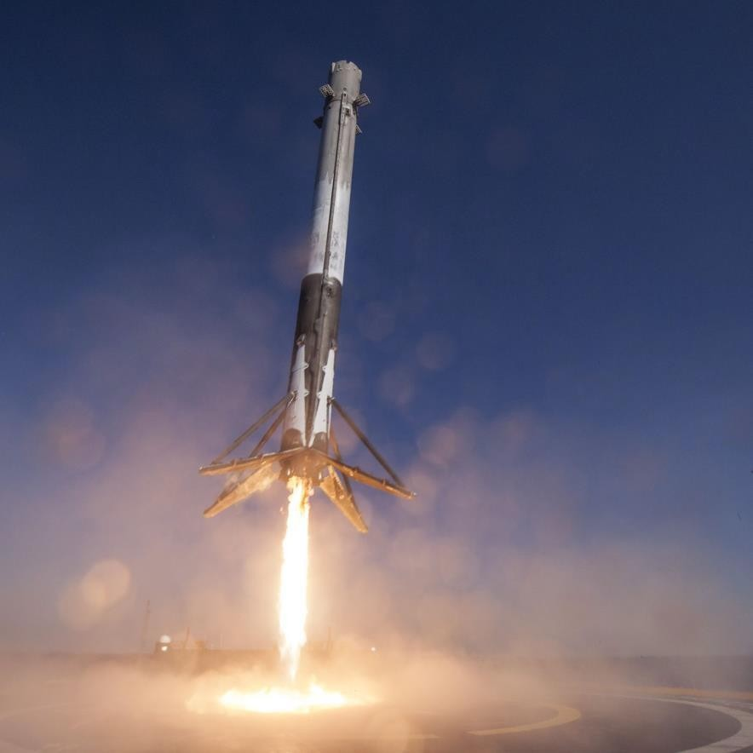
Introduction
Background
The commercial space industry is rapidly expanding.
SpaceX offers significantly lower launch costs compared to competitors ($62 million vs. $165 million USD).
A major cost advantage comes from the ability to recover and reuse the first stage of the rocket.
SpaceX aims to compete with SpaceX in the commercial launch market.
Problem Statement
SpaceX has tasked us with developing a machine learning model to predict the successful recovery of Falcon 9 first-stage boosters.

Slide 5
Methodology
Collected and integrated data from the SpaceX Public API and SpaceX Wikipedia page.
Performed data wrangling and preprocessing by classifying successful and unsuccessful booster landings.
Conducted exploratory data analysis (EDA) using SQL queries and data visualizations.
Developed interactive visual analytics dashboards using Folium and Plotly Dash.
Built predictive classification models to forecast landing success. Optimized model performance through hyperparameter tuning using GridSearchCV.

Slide 6
Data Collection Overview
Method: Hybrid data collection via SpaceX Public API + Wikipedia Web Scraping.
Up Next: Flowcharts detailing both extraction pipelines.
API Fields: 17 core telemetry and launch variables (including coordinates, hardware reuse tracker, and landing specs).
Scraped Fields: 11 core historical launch variables (including customer data, timeline, and payload details).

Slide 7
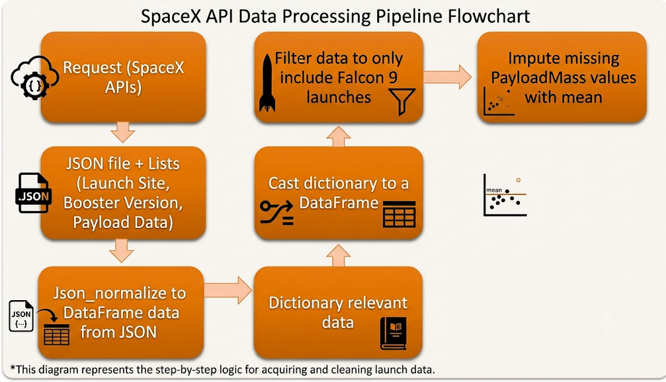
Data collection- SpaceX API

Slide 8
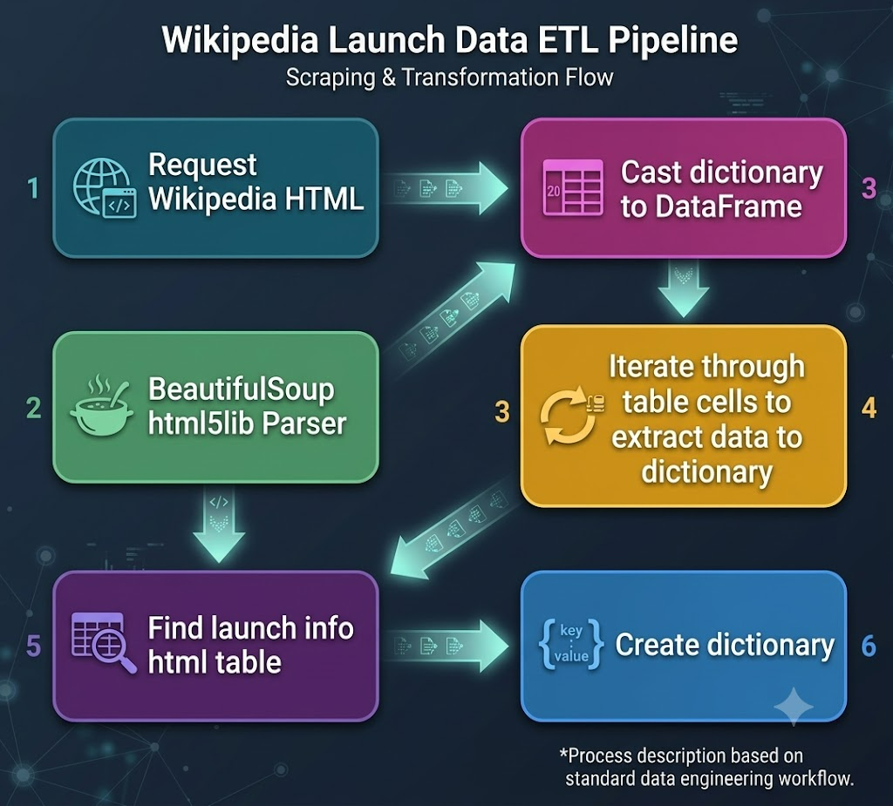
Data Collection-Web Scraping

Slide 9
Data Wrangling
Goal: Create a binary training label (class) from raw landing outcome data.
Logic: Successful landings are assigned a 1; failures or non-attempts are assigned a 0.
Success Criteria (1): Any outcome starting with "True" (ASDS, RTLS, Ocean).
Failure Criteria (0): Any outcome starting with "False" or "None" (e.g., missed droneships, failed return-to-launch-site, or no hardware recovery attempt).

Slide 10
EDA with Data Visualization
EDA Scope: Evaluated 6 key variables (Flight Number, Payload Mass, Launch Site, Orbit, Class, Year).
Visual Toolbox: Used scatter plots, line charts, and bar plots to cross-reference data.
Goal: Spot meaningful patterns to determine which features are viable for machine learning training.
Core Plots: Built 7 distinct visualizations covering payload trends, launch site histories, orbital success rates, and yearly performance progression.

Slide 11
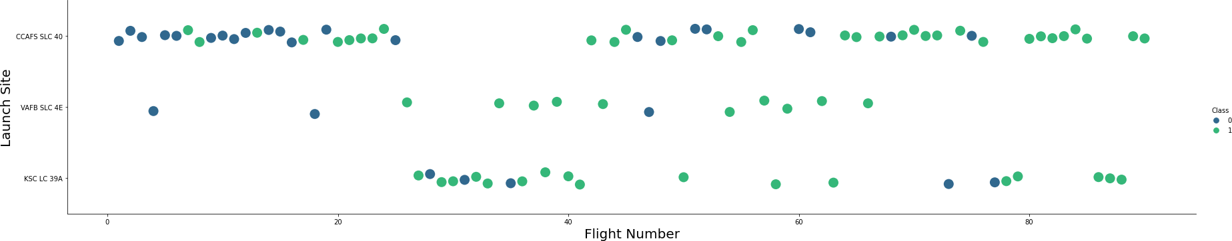
Flight Number VS Launch Site
Green indicates successful launch; Purple indicates unsuccessful launch. Graphics suggest an increase in success rate over time (indicated in Flight Number).

Slide 12
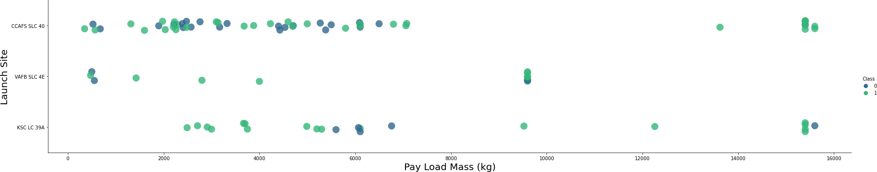
Payload VS Launch Site
Green indicates successful launch; Purple indicates unsuccessful launch.

Slide 13
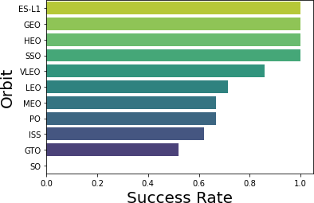
Success Rate vs Orbit Type
ES-L1 (1), GEO (1), HEO (1) have 100% success rate (sample sizes in parenthesis) SSO (5) has 100% success rate
VLEO (14) has decent success rate and attempts
SO (1) has 0% success rate
GTO (27) has the around 50% success rate but largest sample
Success Rate Scale with 0 as 0%
0.6 as 60% 1 as 100%

Slide 14
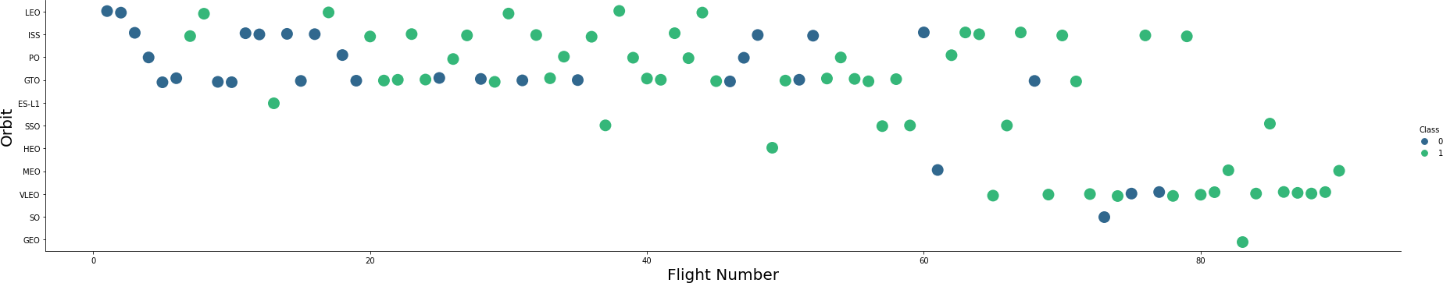
Flight Number VS Orbit type
Green indicates successful launch; Purple indicates unsuccessful launch.

Slide 15
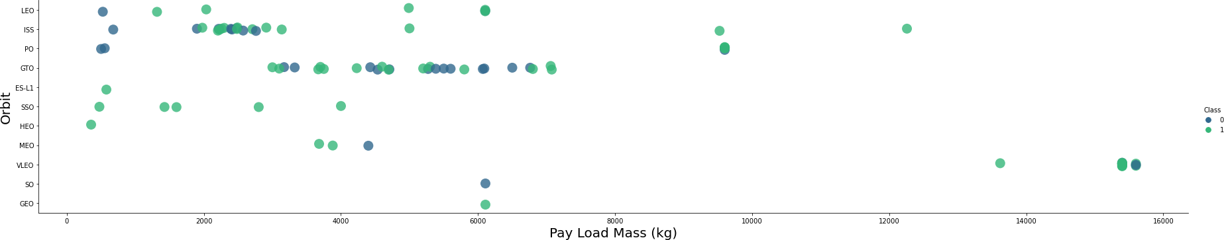
Payload VS Orbit type
Green indicates successful launch; Purple indicates unsuccessful launch.
Payload mass seems to correlate with orbit
LEO and SSO seem to have relatively low payload mass
The other most successful orbit VLEO only has payload mass values in the higher end of the range

Slide 16
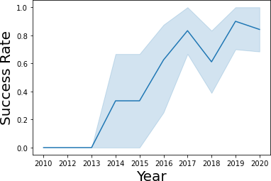
Launch Success Yearly Trend
95% confidence interval (light blue shading)
Success increase over time after 2013 with significant dip in 2018.

Slide 17
EDA with SQL
Storage: Data hosted in an IBM DB2 Database.
Access Method: Queried programmatically using SQL integrated with Python.
Goal: Run initial exploratory queries to audit and better understand the dataset.
Query Focus: Looking closely at launch sites, booster variations, customer payload sizes, mission success rates, and landing results.

Slide 18
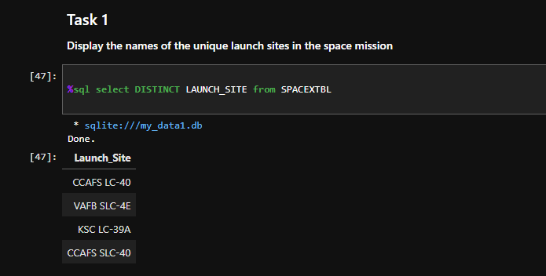
All Launch Site Name
Action: Ran a database query for unique launch site locations.
The Problem: Found typos and old naming conventions (CCAFSSLC-40 and CCAFS LC-40).
The Fix: Cleaned and consolidated the data.
Final Result: Narrowed the dataset down to the 3 actual unique launch sites: CCAFS SLC-40, KSC LC-39A, and VAFB SLC-4E.

Slide 19
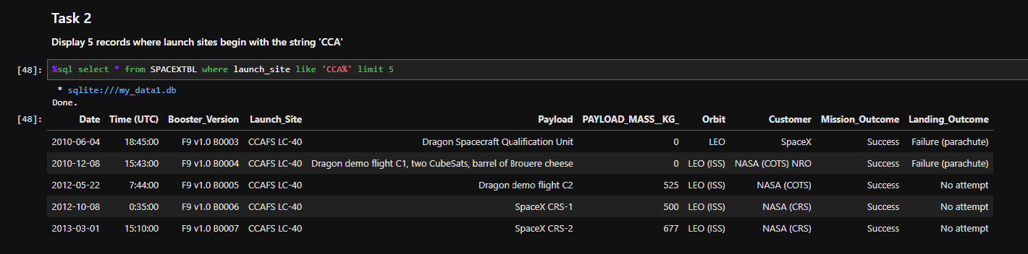
Lauch Site Names Beginning with ‘CCA’

Slide 20
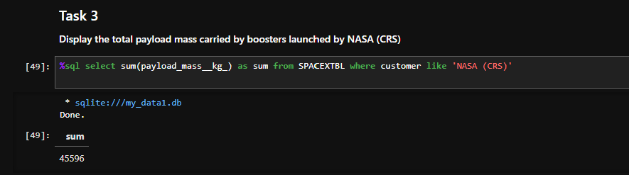
Total Payload Mass from NASA
This query sums the total payload mass in kg where NASA was the customer.
CRS stands for Commercial Resupply Services which indicates that these payloads were sent to the International Space Station (ISS).

Slide 21
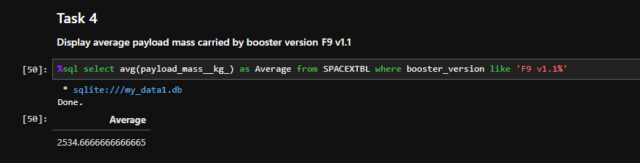
Average Payload Mass by F9v1.1
This query calculates the average payload mass or launches which used booster version F9 v1.1
Average payload mass of F9 1.1 is on the low end of our payload mass range

Slide 22
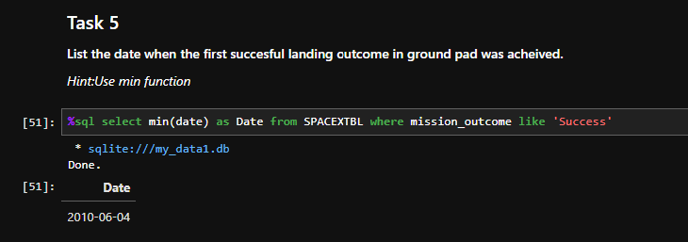
First Successful Ground Pad Landing Date
This query returns the first successful ground pad landing date.
First ground pad landing wasn’t
until the end of 2015.
Successful landings in general
appear starting 2014.

Slide 23
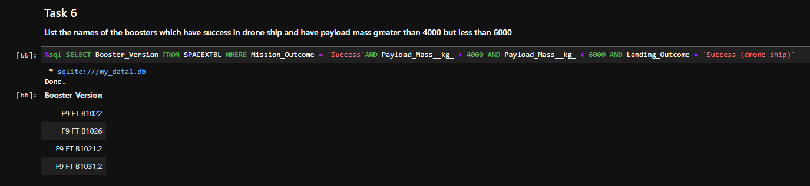
Successful Drone Ship Landing with Payload Between 4000 and 6000
This query returns the four booster versions that had successful drone ship landings and a payload mass between 4000 and 6000 noninclusively.

Slide 24
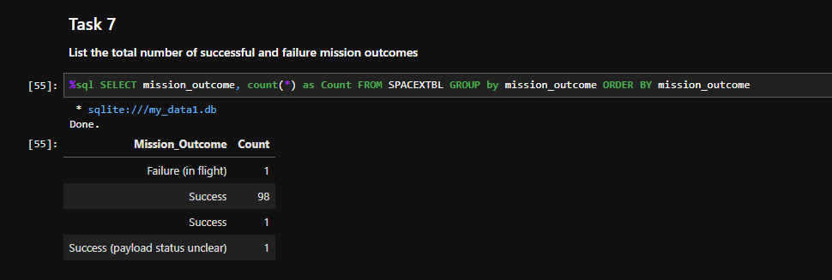
Total Number of Each Mission Outcome
Success Benchmark: SpaceX successfully achieves its primary mission outcome nearly 99% of the time.
Unclear Payload Status: Exactly one launch is flagged with an ambiguous or unconfirmed payload status.
In-Flight Failure: Exactly one mission unfortunately suffered a catastrophic failure during active flight.

Slide 25
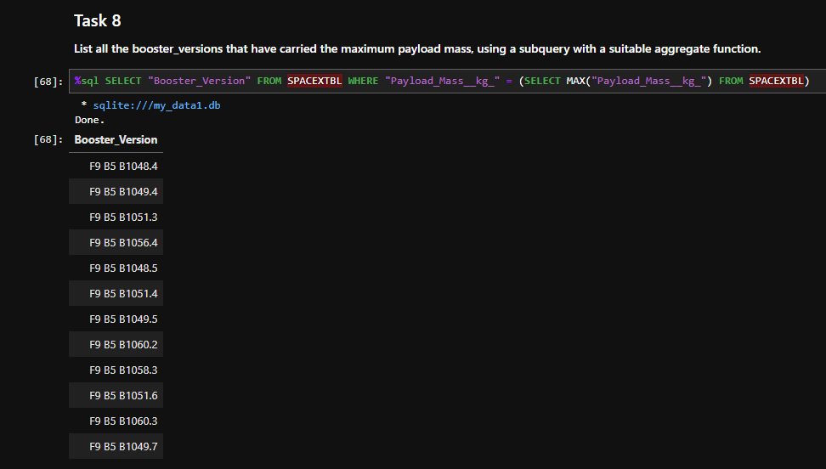
Boosters that Carried Maximum Payload
Capacity Correlation: This uniform pattern strongly indicates that maximum payload capacity closely correlates with the specific booster version deployed.

Slide 26
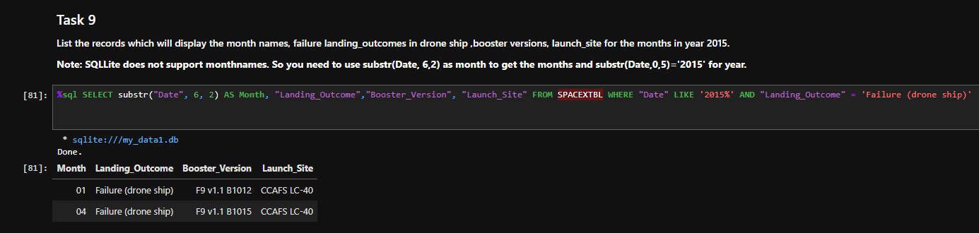
2015 Failed Drone Ship Landing Records
Incident Count: The database returned exactly two occurrences matching these failure criteria for the entire year of 2015.

Slide 27
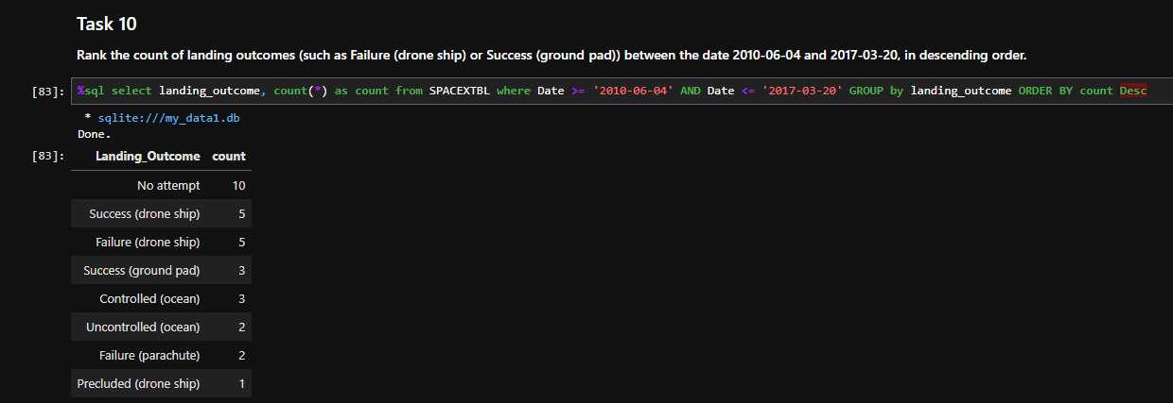
Ranking Counts of Successful Landings between 2010-06-04 and 2017-03-20
Total Count: A total of 8 successful landings occurred during this defined time period.
Landing Modalities: The successful recovery outcomes are split across two distinct logistical formats:
Drone Ship Landings: Over-water recoveries on autonomous spaceport drone ships.
Ground Pad Landings: Return-to-launch-site (RTLS) recoveries on solid ground pads.

Slide 28
Build an interactive map with Folium
Tooling: Leveraged Folium maps for interactive geographic visualization.
What's marked: Launch complexes, successful landing zones, and failed landing locations.
The "Why": Evaluates site selections based on proximity to railways, highways, coastlines, and cities.
Key Insight: Correlates landing performance and site locations with transport infrastructure and safety buffer zones.

Slide 29
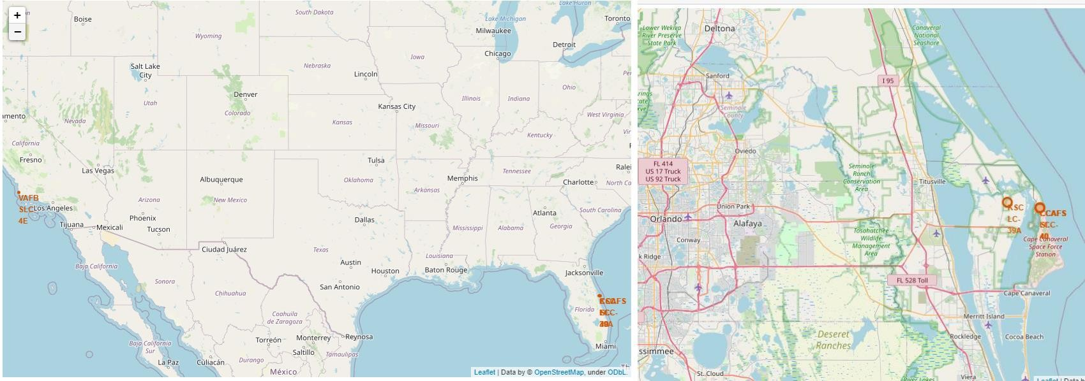
Launch Site locations
Coastal Positioning: Across both views, a consistent geographical trend remains clear: all mapped launch sites are situated near the ocean.

Slide 30
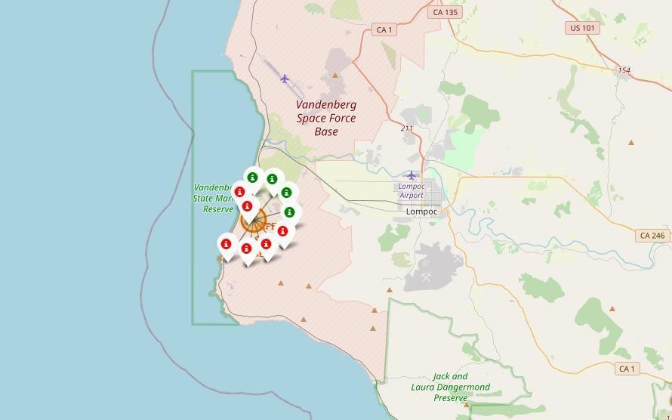
Color Coded Launch Markers
Expanding the cluster for the VAFB SLC-4E launch site provides a clear breakdown of historical landing outcomes at that specific facility:
Successful Landings: 4 green icons are displayed.
Failed Landings: 6 red icons are displayed.

Slide 31
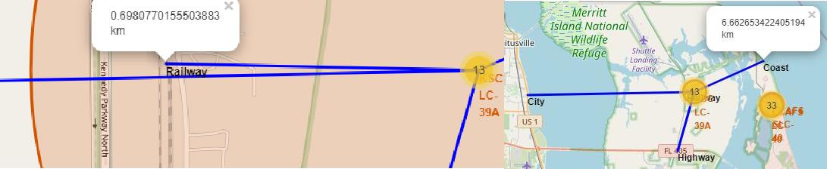
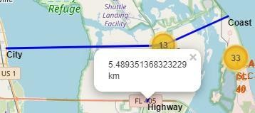
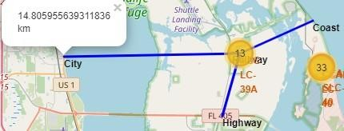
Key Location Proximities
Geographic positioning heavily prioritizes public safety and risk minimization during flight:
Coastal Proximity: Sites are intentionally situated adjacent to coastlines. In the event of a launch failure, the rocket can be safely ditched or crash-land into the sea.
Urban Distance: Launch complexes are built relatively far from major cities to eliminate the hazard of debris or failing hardware plunging into densely populated areas.

Slide 32
Build a Dashboard with Plotly Dash
Dashboard Setup: Composed of two interactive visuals—a pie chart and a scatter plot.
Pie Chart Logic: Tracks launch site success rates; can toggle between total global success distribution and a single site's win/loss ratio.
Scatter Plot Controls: Interactive dropdown filters by launch location, paired with a payload weight slider ranging from 0 to 10,000 kg.
Key Takeaway: The combination allows users to instantly see how launch site location, payload weight, and different booster variants impact mission success.

Slide 33
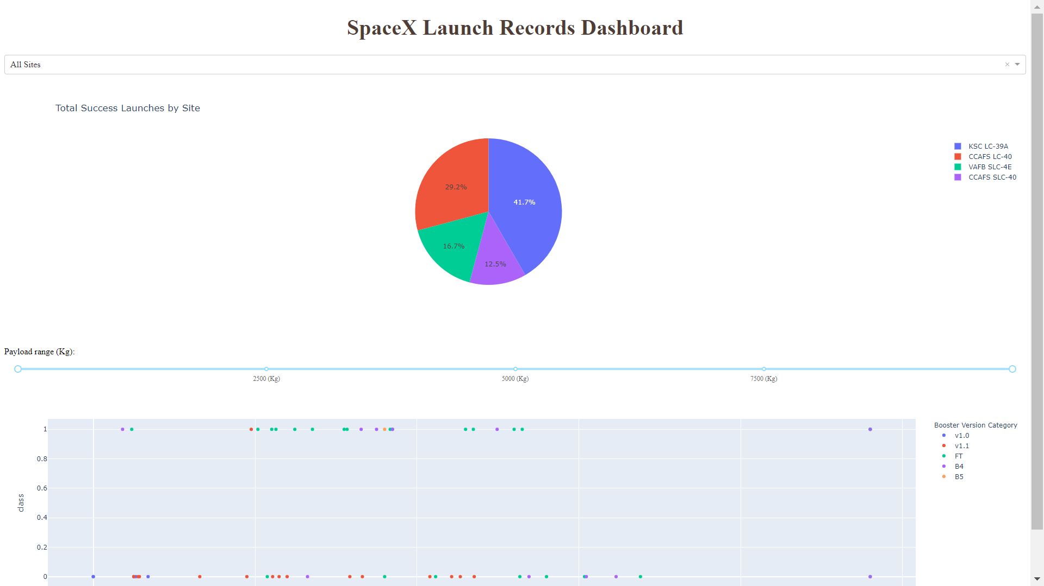
Results of Plotly Dashboard

Slide 34
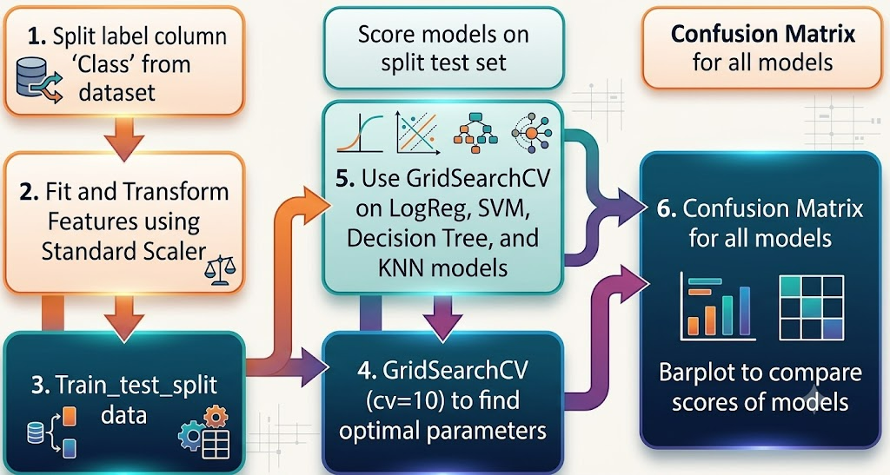
Predictive Analysis

Slide 35
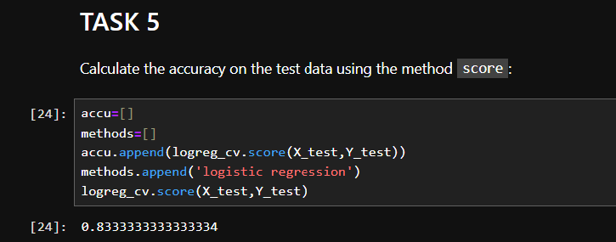
Accuracy Calculation using method score:
All models had virtually the same accuracy on the test set at 83.33% accuracy.

Slide 36
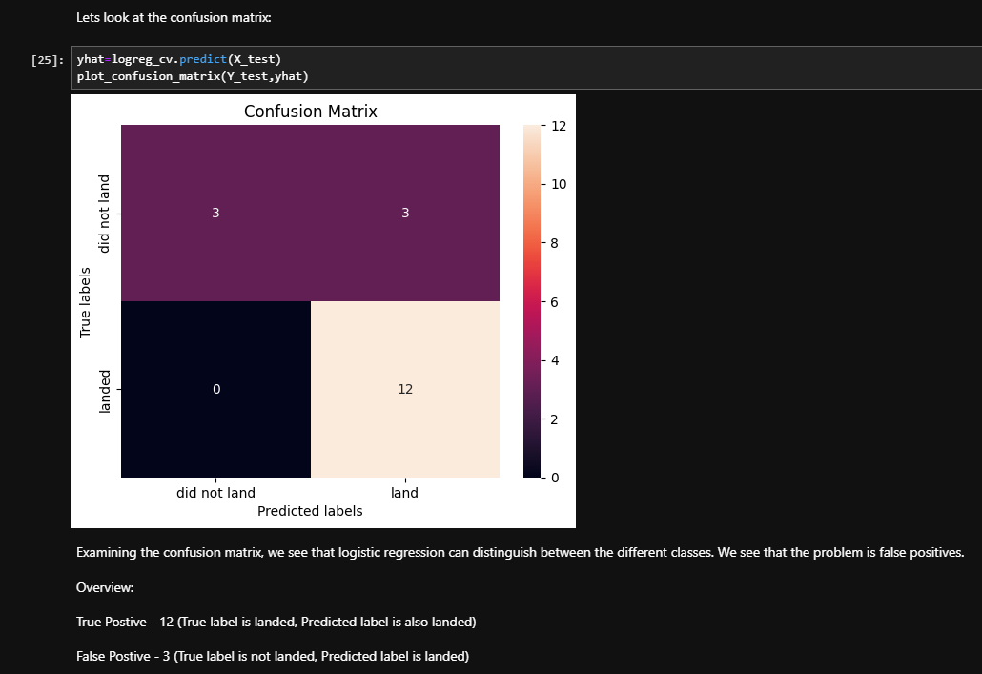
Confusion Matrix
Model Uniformity: All models scored the exact same on the test set, meaning their confusion matrices are identical.
The Wins: 12 successful landings and 3 unsuccessful landings were correctly predicted.
The Flaw: 3 unsuccessful landings were wrongly predicted as successes.
Takeaway: The pipeline has a noticeable bias toward over-predicting successful landings (false positives).

Slide 37
Conclusion
The Mission: Build a model for Space Y to compete with SpaceX by protecting a $100M cost variable (Stage 1 rocket reuse).
The Pipeline: Sourced data from public APIs and Wikipedia, cleaned it in a DB2 database, and built an interactive front-end dashboard.
The Result: Delivered a machine learning model with an 83% accuracy rate.
The Bottom Line: Space Y leadership can now systematically predict booster landing success before launch to optimize resource management.
Next Horizon: Gathering a larger volume of training data is recommended to scale accuracy higher.

Slide 38
Appendix
GitHub repository url:
https://github.com/shre6455/IBM_Data_Science_Professional_Certification
Instructors:
Instructors: Rav Ahuja, Alex Aklson, Aije Egwaikhide, Svetlana Levitan, Romeo Kienzler, Polong Lin, Joseph Santarcangelo, Azim Hirjani, Hima Vasudevan, Saishruthi Swaminathan, Saeed Aghabozorgi, Yan Luo

